Slide 1
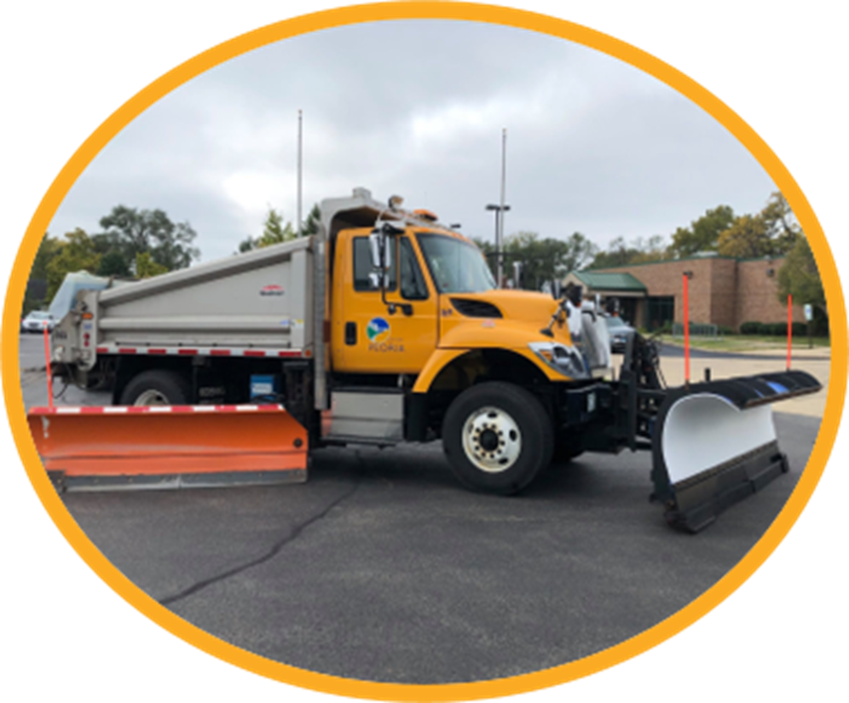

2025-2026
SNOW REMOVAL PLAN
Sie Maroon, Public Works Deputy Director
October 28, 2025

Slide 2
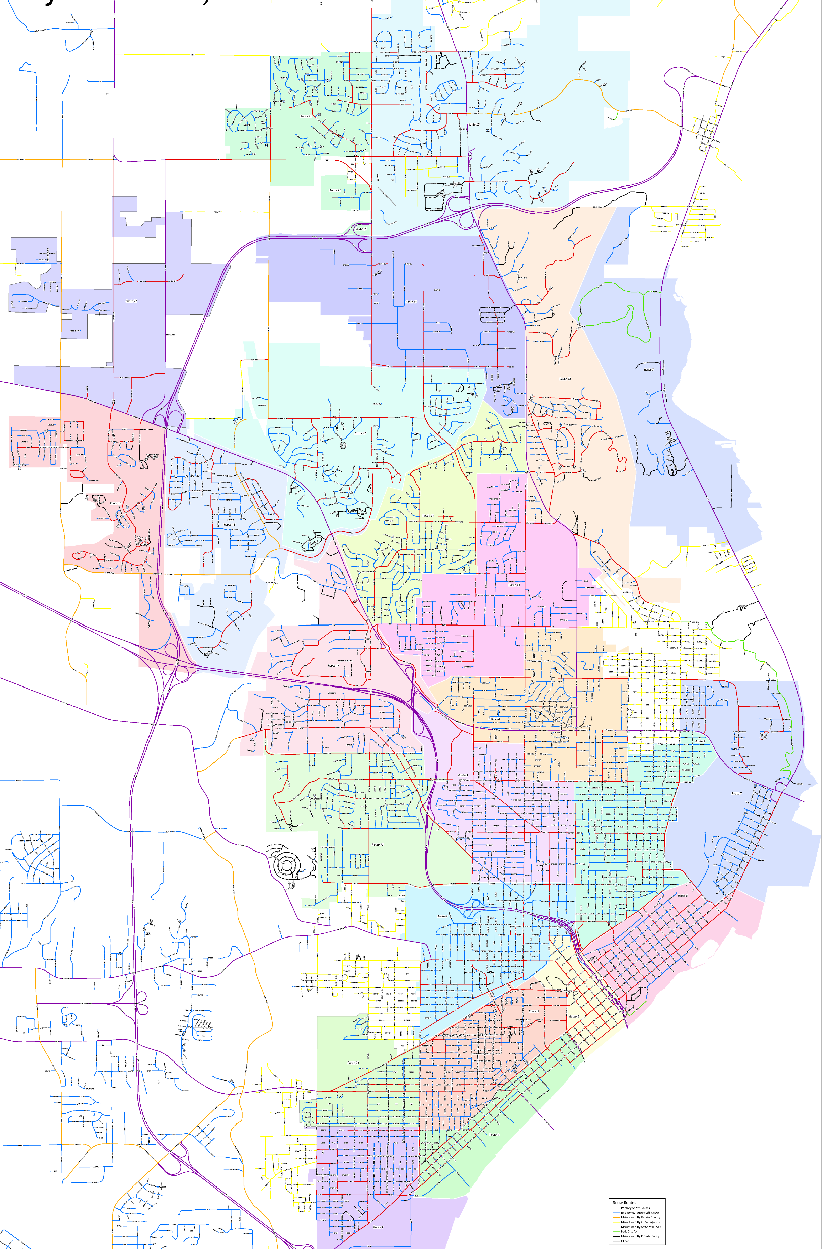
CITYWIDE SNOW ROUTES
For 2025-2026:
Increasing from 21 to 23 snow routes
Designated hill routes (4)
Tandem plow routes (8)
24-hour, around-the-clock operations
Two 12-hour shifts when 2+ inches are forecasted

Slide 3
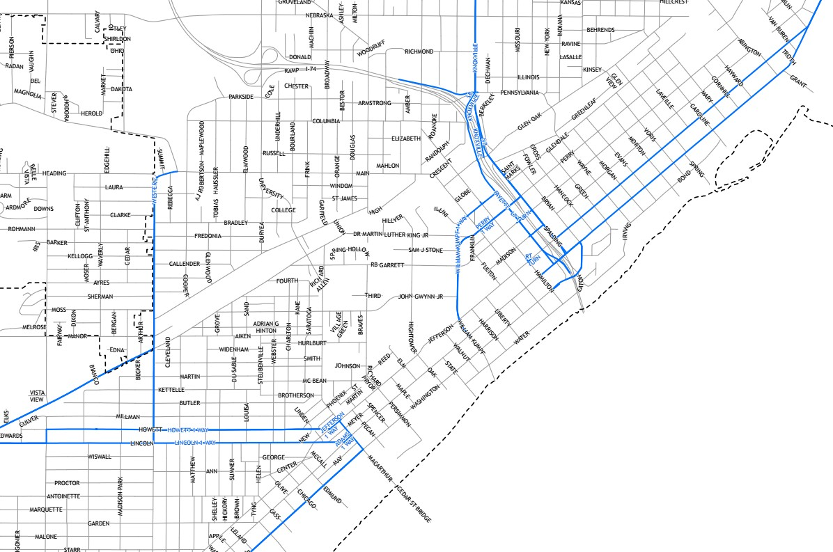
PAST CITY / IDOT ROUTE MAINTENANCE
City Responsibilities (Past)
Maintained several IDOT roads within City limits
Maintained all lanes – drive and parking lanes
Examples: Western Avenue, Lincoln Avenue, Howett Street, Knoxville Avenue

Slide 4
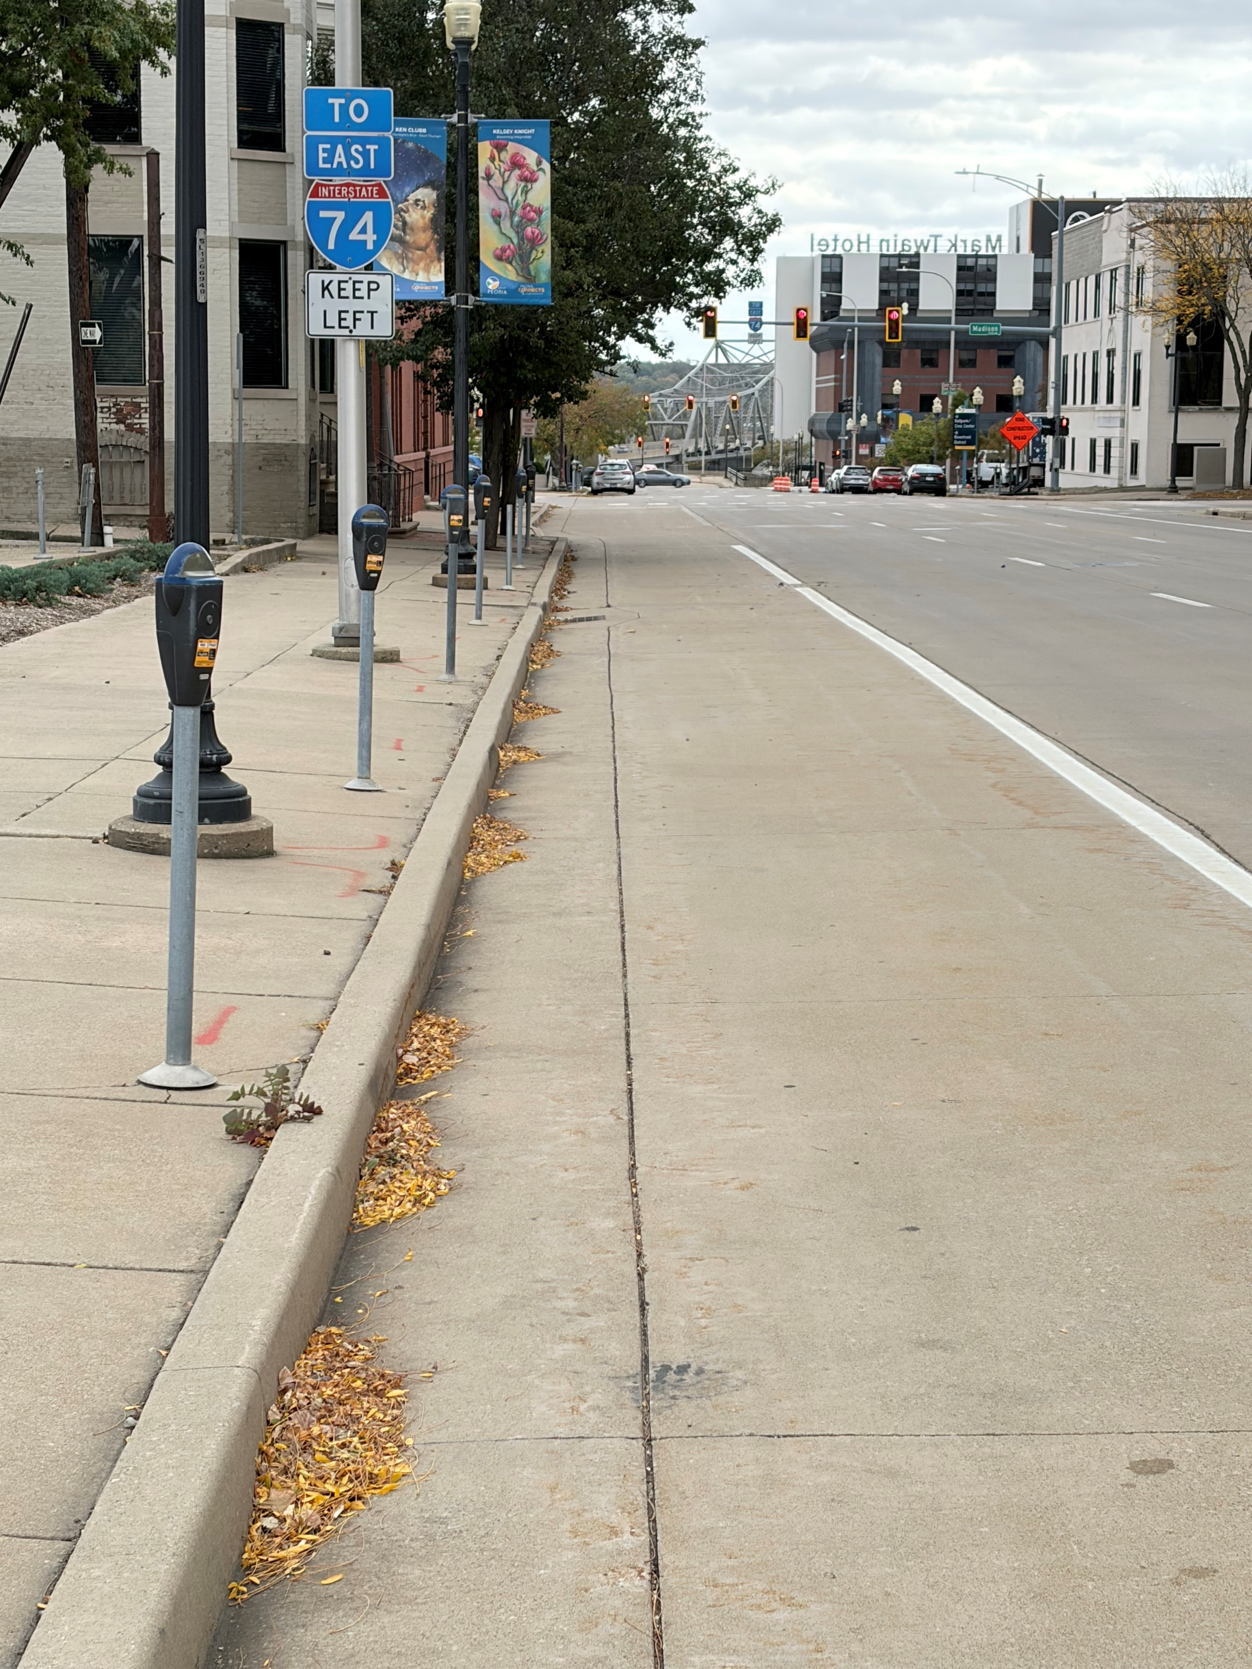
CITY / IDOT MAINTENANCE 2025-2026
* Due to financial and operational impacts, the City and IDOT did not renew a 10-year intergovernmental agreement
Shared Responsibilities (2025-2026)
IDOT will maintain drive lanes on state roads
City will maintain parking lanes on state roads
Parking lanes: Howett Street, Lincoln Avenue, Fayette Street, N.E. Adams Street
The parking lane on Fayette Street, left, is an example of what will be maintained by the City this winter season

Slide 5
SNOW REMOVAL PLAN PRIORITIES
Priority 1: Primary Streets (161 miles)
Arterial, high traffic
Adjacent to schools and medical facilities
Priority 2: Residential Streets (332 miles, 80 miles of alleyways)
Low traffic, residential, cul-de-sacs
*The City DOES NOT have a “Bare Pavement” Policy
Goal:
To maintain safe travel routes during the winter season and to restore mobility for the traveling public within a reasonable timeframe following winter storm conditions.
*Snow removal is a public safety operation

Slide 6
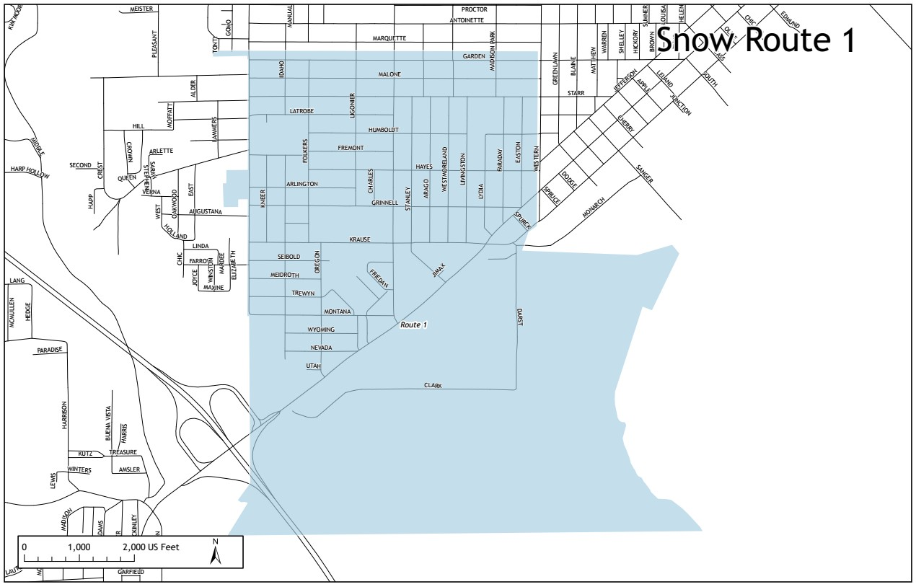
TIMING
Between 2-6 inches:
Citywide arterial snow removal within 24 hours
6 inches or more:
Citywide arterial snow removal within 36 hours
A-B-C Sub-routes:
A rotational approach to plowing residential streets
Storm Event 1 = A-B-C | Storm Event 3 = C-A-B Storm Event 2 = B-C-A | Storm Event 4 = A-B-C

Slide 7
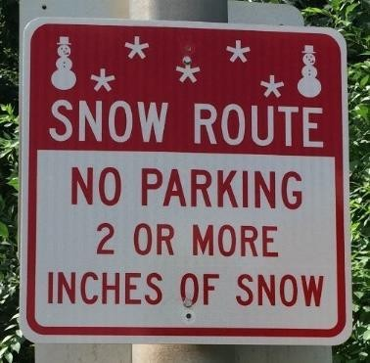
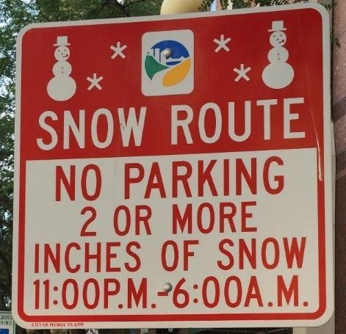
PARKING ENFORCEMENT
Snow Parking Bans
Two types of parking bans
Type 1: Primary Routed Streets and Downtown Business District Streets
Signs are posted on Primary/Downtown Business District snow routes
Automatically in effect when snow reaches 2 or more inches (in effect for 48 hours)
Type 2: Citywide parking bans (based on emergency declarations)
*Citations may be issued every 24 hours
Primary Routed Streets
Downtown Business District

Slide 8
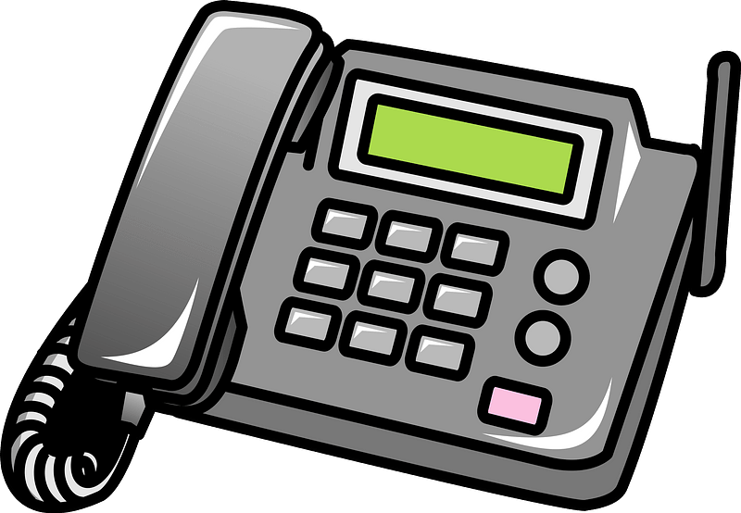
INFORMATION AND RESOURCES
Releases sent through GovDelivery
Communication Groups
HOA/Neighborhood Associations
Subscribers
Facebook and Nextdoor
City website: www.peoriagov.org
Peoria Cares - Phone (309)-494-2273, App, Website
Select billboards with parking ban information as needed

Slide 9

CONTACT PUBLIC WORKS
Public Works - (309) 494-8800
Prerecorded storm updates - (309) 494-8830
Snow Call Center - (309) 494-8850
Snow Call Center:
Activated during significant storms
Dedicated staff to answer calls
Voicemail backup
Illinois Department of Transportation – (309) 671-3333
QUESTIONS?

